Slide 1
Cloud Strategy
Enterprise Architecture Team
Ajay Patel

Slide 2
Objectives
Key objectives of this document includes:
Business drivers of the Cloud computing
Highlight Cloud Principles
National Grid’s current strategy on cloud computing service adoption
High-level adoption approaches, methodologies, and roadmaps

Slide 3
Business Drivers
National Grid is going through IT to DT transformation journey
Cloud computing is the foundation for digital technology
Cloud computing that drives greater speed, agility and innovation through this democratization of IT
Digital business requires speed and agility that cloud computing provides through the use of cloud services that become available to a broader set of users through a self-service interface
Business transformation initiatives that necessitate capabilities such as IoT and Edge computing
Digital and Innovation initiatives that could leverage cloud AI/ML capabilities

Slide 4
Cloud Principles
SaaS first, PaaS second and IaaS third
Consider SaaS offerings where they meet business needs
Use PaaS offerings where practical to reduce maintenance and development time.
Leverage built-in services to reduce development effort
Enable consumers to consume standard patterns through self-service.
Support a repeatable automated deployment process that balances user requirements with security and cost controls.
Automate everything and anything where possible
Net-new custom application solution should be developed based on Cloud-native architecture
Evaluate the benefits of cloud based on a total cost of ownership (TCO) compared with the costs of other technology platform business solutions
Select right types, configurations and auto-scaling (horizontally and vertically as needed) along with purchasing options based on the business solution requirements
Take an enterprise risk management perspective to manage the adoption and use of cloud
Cloud Agnostic tooling at the PaaS level versus Cloud Native where possible

Slide 5
Our Ambitions
Transform our services and landscapes in support of a Hybrid Cloud pattern/approach
Embrace Open Standards and industry best practices
Provide seamless Cloud-like experience with automation and software defined infrastructure
Multi-cloud, multiplatform multivendor approach underpinned by standards, patterns and best practices from Enterprise Architecture

Slide 6
As-Is State of National Grid Cloud
Microsoft Azure is the strategic vendor for cloud services
National Grid has 30 instances (subscriptions) for Microsoft Azure (all but 2 are Shadow IT)
Current MS Azure estates lack key controls, automation, integration, standards, etc.
AWS is in use as Shadow IT
Oracle Cloud Infrastructure (OCI) is flagged as contain by Enterprise Architecture
Shadow IT does not have the same eco system and support as the Azure Core service.
The Cloud Hosting and Data Center team provide the guardrails for standards and policy as well as the financial tracking and optimization for resource spend.
Use cases are reviewed and must be compliant with the security data classification standards.

Slide 7
To-Be State of National Grid Cloud
Consolidated landscapes to 2 primary Azure2.0 estates (US & UK)
Fully Automated deployment and provisioning with integration to ServiceNow for ticketing and Initiating Azure Cloud Foundation (ACF) Azure provisioning workflow
Multi Cloud / Hybrid Cloud support, management and monitoring
Agnostic Standards, Patterns and best practices with Enterprise Architecture including Cloud Decision Trees and guidance.
AWS to be evaluated
Oracle Cloud Infrastructure (OCI) phased out

Slide 8
Our Approach to achieve To-Be State
Phase I (FY21) - Build a new Cloud Center of Excellence and new Azure Cloud Foundation in partnership with Microsoft (underway). This will yield new standard services such as:
ServiceNow – Integrated and Automated Provisioning request management
Security - Integration of event monitoring Splunk (SIM)
SecDevOps – Integration with Jenkins and Jira (user stories) and Azure CI/CD best practices.
IaC – Automatic provisioning of Infrastructure as Code (IaC) for several Pilots and release several applications on the Azure environment.
Phase II (FY22) – Migrate workloads
On-Prem to Cloud hosting migration with strategic vendor partnerships
Migrate or legacy Azure estates to Next Generation Azure (Azure Cloud Foundation – ACF with CCOE)
Automate Cloud provisioning
Migrate legacy on-prem or Azure to new platform to reduce technical debt.
Roadmap (Draft) -

Slide 9
Azure 2.0 - Cloud Adoption
Successful Cloud Adoption depends on building cloud foundation and Cloud Center of Excellence.
Azure Cloud Foundation
Design and implement Azure as a platform for new cloud-based applications and services
Develop an infrastructure-as-code solution and implement a design using DevOps practices
Discovery of existing Azure environments to recommend best practices, improve service management and reporting
Cloud Center of Excellence (CCoE)
Build upon Azure Cloud Foundation (ACF) and is focused on architecting and engineering Azure Cloud Services using a DEVOPS framework.
Primarily focus on “Born in the Cloud” or “Cloud Aware” applications.
Follow an agile approach to capture business requirements
Use reusable deployment packages that align with security, compliance, and service management policies
Maintain a functional Azure landing platform that aligns with operational procedures as a support for the workloads
Product based development approach to enable adoption of security certified Azure services

Slide 10
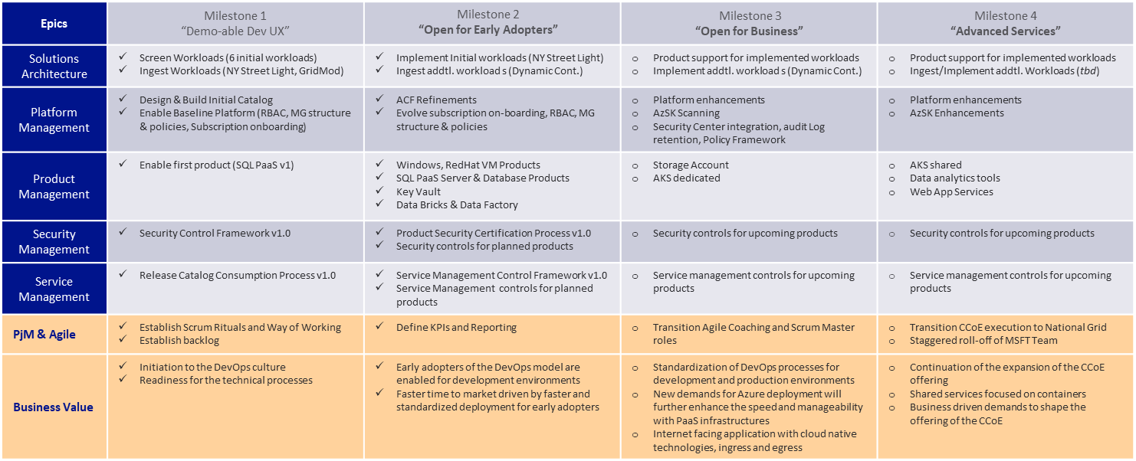
CCoE Roadmap

Slide 11
Cloud PaaS Services Roadmap
9.3.1 Public Cloud
FY21
FY22
FY23
FY24
Q1 | Q2 | Q3 | Q4
Azure Log Analytics & Event Hubs
requirements
deployment patterns
Automated deployment with security framework
Define support framework
Continuous improvements - enable new features
Azure Kubernetes Services – Container Orchestration
requirements
deployment patterns
Automated deployment with security framework
Define support framework
Continuous improvements – enable new features
Azure Data Factory & Data Bricks
requirements
PoCs in UK underway. More work needed to validate this a tactical until Enterprise Strategy is available for use​
deployment patterns
Automated deployment with security framework
Define support framework
Continuous improvements - enable new features
Azure Redis Cache
requirements
deployment patterns
Automated deployment with security framework
Define support framework
Continuous improvements – enable new features
All tooling are subject to Enterprise Review
Technical Capability Model
Ready for consumption

Slide 12
Cloud PaaS Services Roadmap (Cont..)
9.3.1 Public Cloud
FY21
FY22
FY23
FY24
Q1 | Q2 | Q3 | Q4
Azure Service Bus
requirements
deployment patterns
Automated deployment with security framework
Define support framework
Continuous improvements – enable new features
Azure IoT suite
PoCs in UK underway. More work needed to validate this against CIO strategies
Explore capabilities of PaaS services offered under Azure IoT suite v/s Azure SaaS service IoT Central ; deep dive; map capabilities against business requirements ; conduct PoC; choose best fit services
Azure AI + ML
Explore capabilities of cognitive services offered under Azure AI + ML umbrella ; deep dive; map capabilities against business requirements ; conduct PoC; choose best fit services
Deployment patterns
Automated deployment with security framework
All tooling are subject to Enterprise Review
Technical Capability Model
Ready for consumption

Slide 13
Appendix

Slide 14
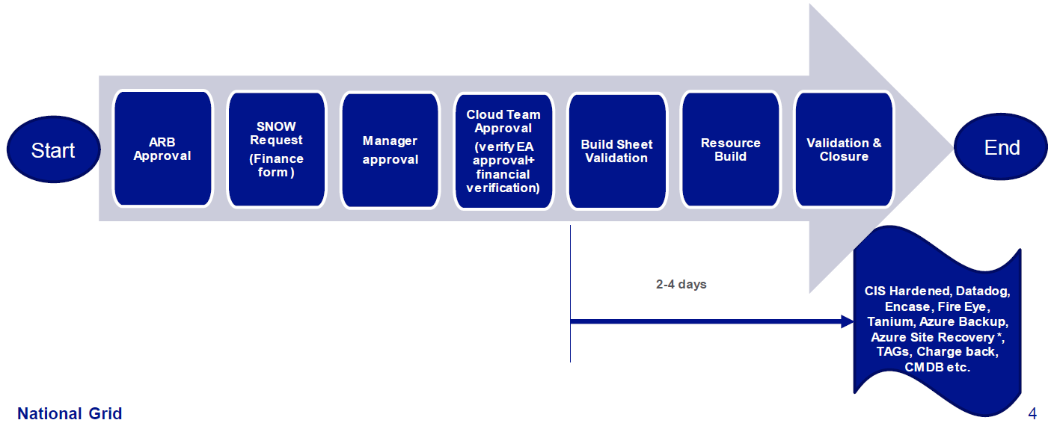
Azure 1.0 as-is cloud operating model
Azure 1.0 U.S and U.K is platform of choice until Azure 2.0 is open for business ( expected April 2021)
Follow Cloud Decision Flow criteria (put link here) to decide if workload is suitable to host in Azure 1.0
Governed by National grid ; Managed and supported by Wipro
Requisition Life Cycle

Slide 15
Azure 2.0
CCoE at the center of operating model
Product based approach of the cloud platform.
By adopting a product mindset, each team can take the responsibility and accountability for increased awareness, ownership and operational excellence through self-healing systems that can recover quickly using integrated failure detection and remediation
A product in this context is defined by
Performing a constrained number of common tasks very well,
Having clearly defined inputs and outputs,
Being useful to multiple customers, and
Continuously improved to meet the needs of those customers

Slide 16
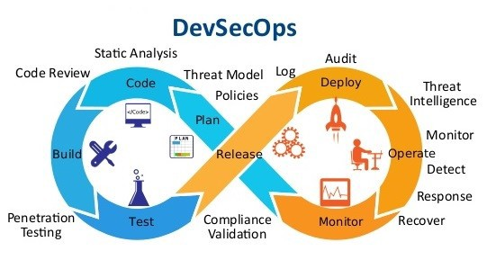
Azure 2.0 Cloud Operating Model
CCoE Centric
DevSecOps
Automate where possible
Agile Delivery model
Governance
Service Management
Service Delivery
CCoE Team
Dev Sec Ops Agile Delivery Model
Security / Compliance/ Risk
Solution Architecture
Service/Product Catalog

Slide 17
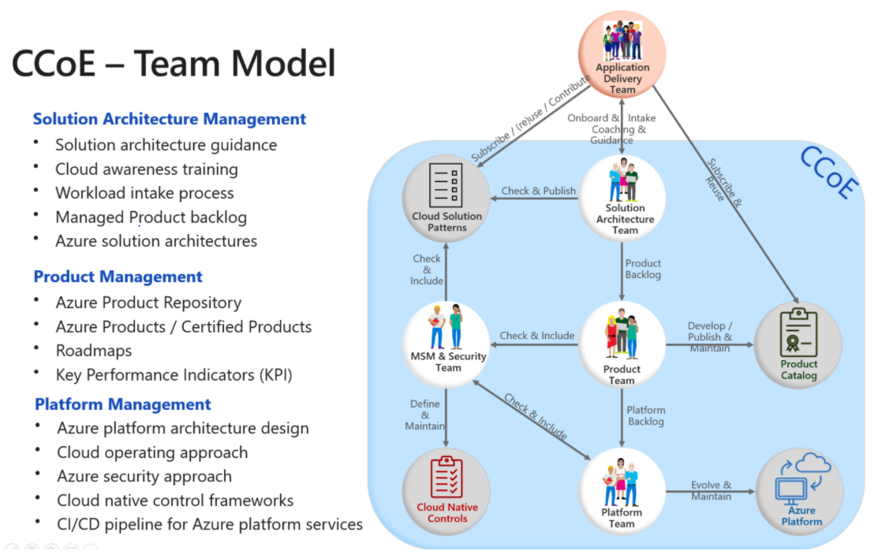
CCoE Team Model

Slide 18
CCoE Model - Application Team’s Experience

Slide 19
Cost Factors for Running in the Cloud
Factors that can reduce cloud costs:
• Leverage built-in services to reduce development effort.
• Use PaaS offerings where practical to reduce maintenance and development time.
• Choose software platforms where licensing agreements support cloud deployments.
• Consider SaaS offerings where they meet business needs.
• Use reserved instances to handle normal load.
• Use auto-scaling to handle peak load.
• Turn-off test and development tiers when not in use (40 hours/week vs 168 hours/week).
• Take advantage of central cloud resources where available.
• Pay only for today’s requirements.

